Slide 1

The Better Betting Pool
A Django/python software engineering project by team c
Will Blankenship, ryan manus, & david rosenberg

Slide 2
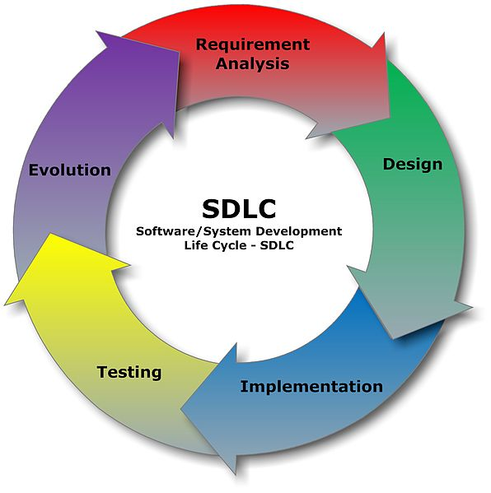
Requirements Gathering
Betting Pool hard copy provided by Dr. Bartz
Questions and Answers in Class
Python and Django Tutorials
STACK OVERFLOW!
Trial and Error
Refactoring

Slide 3

Preliminary Planning & Design
Team Meeting Times
Roles Established
Plans for Classes:
Betting Sheet
Player
Game
User Stories
Administrator Track
User Track
Plans for Web Page Design

Slide 4

Documentation
Project Charter
Problem Statement
Business Requirements Document
Status Reports
Sprint Plans
Architecture Documents
Design Documents
User Stories
Test Cases

Slide 5
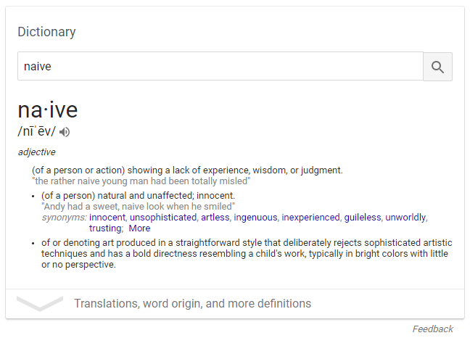
Sprint 1: Administrator Track
Waited to the Last Minute to begin implementing design into code
Got basic classes created
Learned how to use admin.py to make nice Django admin pages

Slide 6
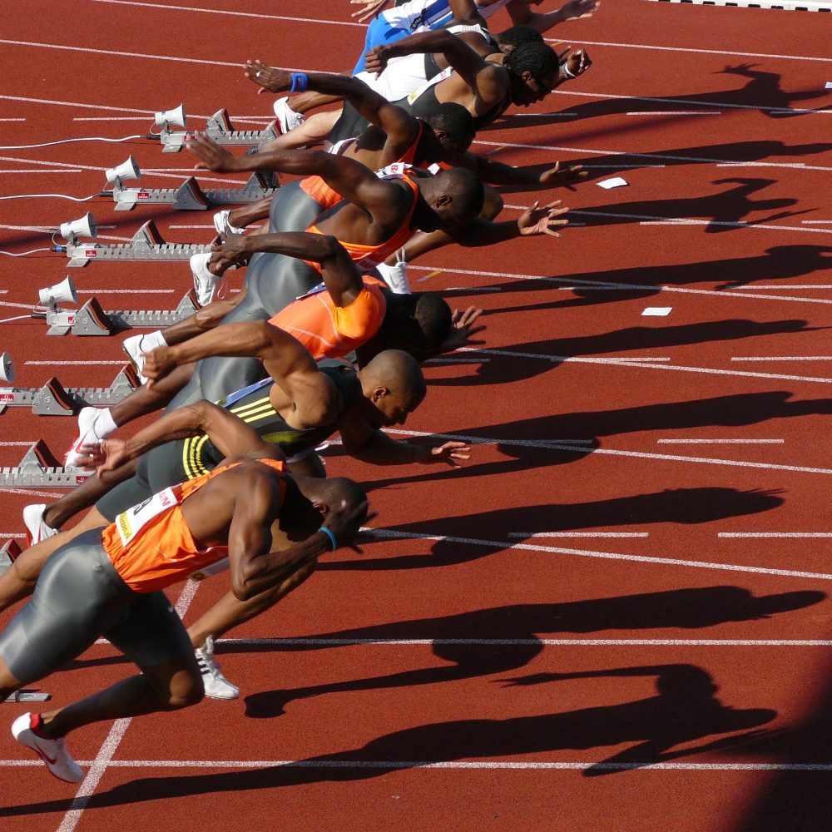
Spint 2: User Track
Working with Objects in views.py
Learning how to use forms to login and sign up
Using templates, passing objects into templates
Request.POST?!?!
Lots of manual testing
REFACTORING!!!

Slide 7
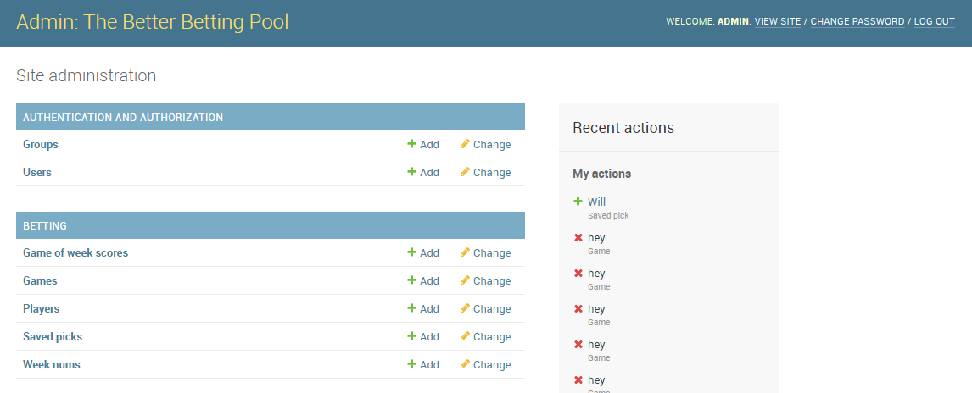
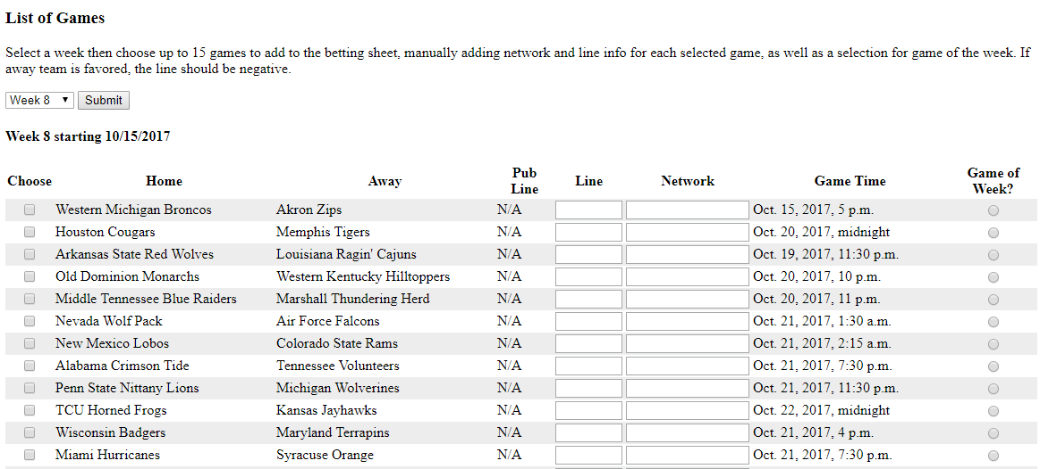
Sprint 3: Using API for Admin

Slide 8
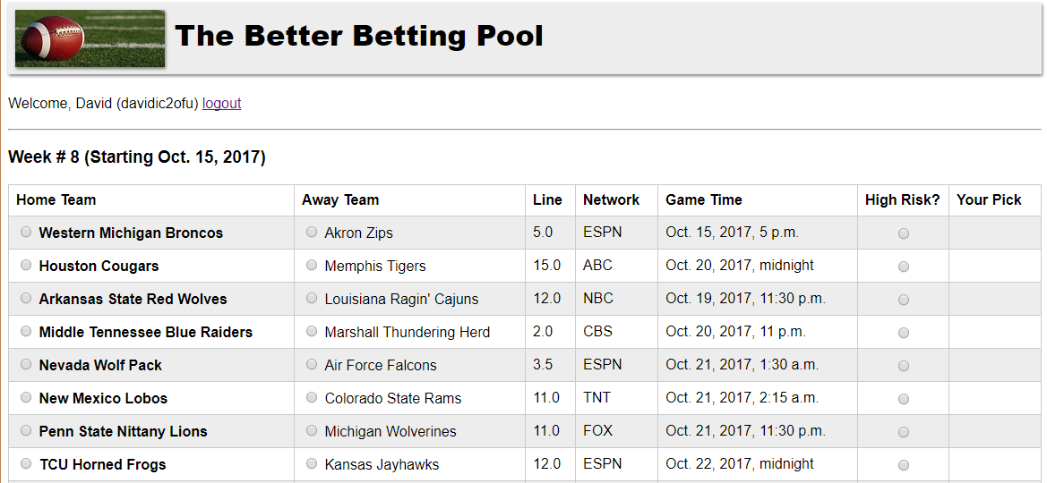
Demonstration

